Slide 1
Default Report
2023 Health Equity Research Intensive
October 15th 2023, 9:14 pm MDT

Slide 2
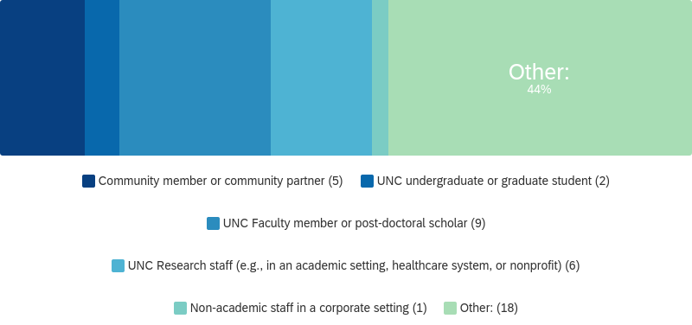
Q2 - Which of the following best describes your day-to-day work (i.e., the work in which you might apply what you’ve learned from the Health Equity Research Intensive)?

Slide 3
Q2 - Which of the following best describes your day-to-day work (i.e., the work in which you might apply what you’ve learned from the Health Equity Research Intensive)?
# | Field | Minimum | Maximum | Mean | Std Deviation | Variance | Count
1 | Which of the following best describes your day-to-day work (i.e., the role in which you might apply what you’ve learned from the Health Equity Research Intensive)? - Selected Choice | 1.00 | 6.00 | 4.22 | 1.80 | 3.24 | 41

Slide 4
Q2 - Which of the following best describes your day-to-day work (i.e., the work in which you might apply what you’ve learned from the Health Equity Research Intensive)?
# | Answer | % | Count
6 | Other: | 43.90% | 18
3 | UNC Faculty member or post-doctoral scholar | 21.95% | 9
4 | UNC Research staff (e.g., in an academic setting, healthcare system, or nonprofit) | 14.63% | 6
1 | Community member or community partner | 12.20% | 5
2 | UNC undergraduate or graduate student | 4.88% | 2
5 | Non-academic staff in a corporate setting | 2.44% | 1

Slide 5
Q2 - Which of the following best describes your day-to-day work (i.e., the work in which you might apply what you’ve learned from the Health Equity Research Intensive)?
# | Answer | % | Count
 | Total | 100% | 41

Slide 6
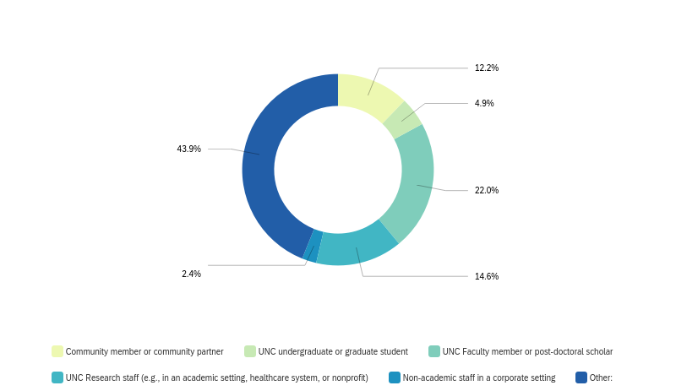
Q2 - Which of the following best describes your day-to-day work (i.e., the work in which you might apply what you’ve learned from the Health Equity Research Intensive)?

